Slide 1

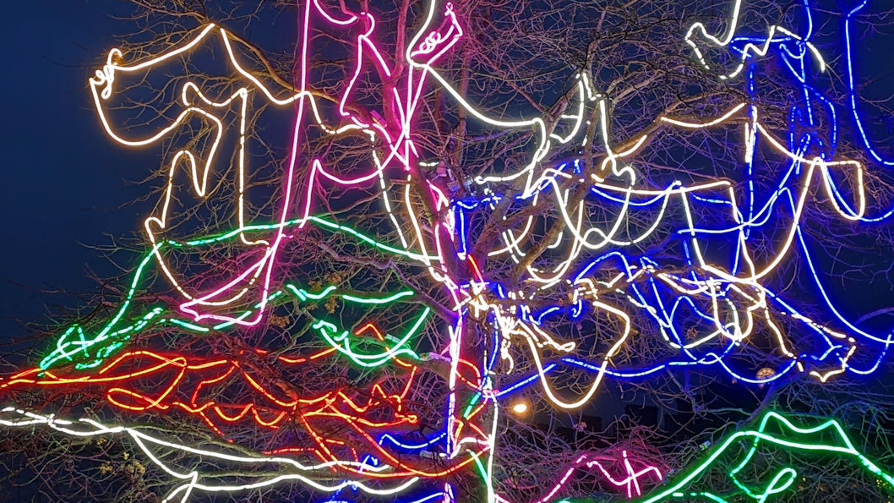
BUILDING A NATIONAL ALLIANCE FOR MEDIA AND INFORMATION LITERACY
A panel-led webinar discussion
UNESCO Global MIL Week
21 November 2024

Slide 2
OUR PANEL
Irene Andriopoulou
Media Analyst/Researcher and Senior Research Fellow, ELIAMEP
Stéphane Goldstein
Secretary to the MILA Board and Executive Director, InformAll
Julian McDougall
Chair of MILA and Professor of Media and Education, Bournemouth University
Jane Secker
Associate Professor in Educational Development, City St George’s, University of London

Slide 3

NATIONAL CONTEXT (1)
Media literacy (and by implication, MIL) is increasingly recognised as a public policy issue, driven by concerns about online harms.
The Online Media Literacy Strategy (2021) is the national framework for developing media and information literacy.
The UK Government (DCMS/DSIT) and Ofcom have funded a number of pilot projects over 2023-2024 to develop media literacy among particular audiences.
Ofcom has identified 123 media literacy initiatives across the UK, mostly run by third sector organisations.
The 2023 Online Safety Act addresses media literacy and places obligations on Ofcom to promote it.

Slide 4
NATIONAL CONTEXT (2)
Under the terms of the Online Safety Act, Ofcom has set out its own three year Media Literacy Strategy (October 2024).
Ofcom is also supporting the development of Media Literacy Outcome Descriptors and Teacher Training Mapping (work currently in progress).
Minimal Digital Living Standard – includes critical digital literacy.
New UK government has launched its Curriculum and Assessment review for schools in England (July 2024).
Currently out to consultation.
Opportunity to get better recognition for MIL in school education.
The government has already been saying encouraging things about the importance of critical thinking in education and the need to equip young people to address mis/disinformation.

Slide 5
WHERE WE ARE NOW: Media literacy IN POLICY
A RIGHT FOR CITIZENS
Ecosystem | UNSDG | Media Literacy | UK Ofcom ML
The communication ecosystem is rich, diverse, generative, eco-centric & rights-protecting environment. We demand equal and diverse communication ecosystems and safe online and data environments. | Well-being for all at all ages. Promotion of a culture of peace and non-violence, global citizenship and appreciation of cultural diversity | People engage more with trustworthy and diverse media and improve the health of the media, information and data ecosystem through these access changes. | Critical thinking about content: Actively questioning and challenging online information. Online safety, privacy and protection from harm: Managing risk, safeguarding privacy and spotting and avoiding harms.
Communication actors, platforms and technology designers operate for social goals and in the public interest. | Universal & affordable access to information and communications technology and Internet. Public access to information to protect fundamental freedoms. | People expect to have access to media which acts in the public interest and an online and data environment which is safe and protects digital rights. Media practitioners, policy makers and institutions’ obligations to more resilient and media literate publics reduce negative media impacts over time. | Engaging Platforms: Platforms and broadcasters will provide better media literacy support for their users.
Everybody has the means to be fully included in the communication ecosystem and to engage with media, information, technology and data as fully functioning, critically aware citizens. Publics are motivated to “interrogate how the technology works, even when we are trying to accommodate it into our everyday lives.” (Natale, 2021: 132). | Equal access to basic services + appropriate new technology. All youth and a substantial proportion of adults, both men and women, achieve literacy. People everywhere have relevant information and awareness. | People have the critical means to evaluate the credibility, fairness and diversity of their access to media and information. People are exercised by the unhealthy consequences of unverified content and information and data exploitation and motivated to encourage others to be more mindful. | ALL
Communication actors and publics believe that it is important for different groups in society (including the marginalised and seldom heard) to be fairly represented in media, information and communications. | Enhance the use of enabling information and communications technology to promote the empowerment of women. | People engage with and advocate for more diverse media representations and this generates dialogue between groups and reduces polarisation of discourse. | Critical thinking about content. Actively questioning and challenging online information
People think of themselves as media makers / information providers. We see the connection between communication and health, civic society, educational and economic opportunities. | Enhanced representation and voice. Effective public, public-private and civil society partnerships | Diverse publics represent themselves, taking opportunities provided by media literacy projects and programmes which include them. | Access, use and content creation. Accessing media and getting online, using technology and creating content Digital citizenship and media engagement. Making the most of online opportunities and media to be a citizen in the world

Slide 6

INTERNATIONAL CONTEXT (1)
2024 UNESCO Global Media and Information Literacy Week. Proclaimed in 2019 as official by 193 countries globally.
This year’s theme: ‘The new digital frontiers of information: Media and Information Literacy for public-interest information’.
Digital campaign: hashtag#PostWithCare.
Focus on content & prosumer: user-consumer - producer.
Trends and Challenges: G-AI, digital platforms, social media.
New focus groups:
Influencers - kid-fluencers.
Digital content creators (UGC).
New free online course: ‘Digital Content Creators and Journalists: How to Be a Trusted Voice Online’. Course date: 18 November - 15 December.
Register now : https://bit.ly/3BVywHy

Slide 7
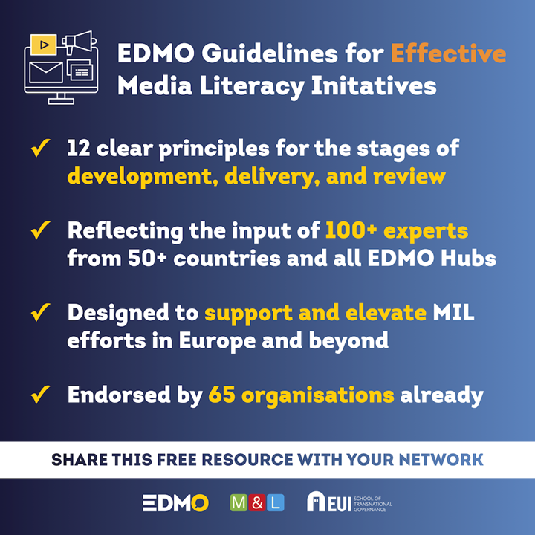
InterNATIONAL CONTEXT (2)
Released: 21 October 2024, EDMO.
Available, free download: www.edmo.eu
Based on 12 Principles on the effectiveness of Media Literacy projects at the stages of:
a) development
b) delivery
c) review
Aim: help increase the quality of media literacy across Europe.
Target group: anyone involved in the development of media literacy initiatives, including civil society, educators, policy makers, those in the media or tech industries.

Slide 8

Mila BACKGROUND
MILA is an independent collaborative initiative:
Set up in October 2021, following the publication of the Online Media Literacy Strategy.
Registered as a charity in December 2023, now with 11 trustees.
One of the challenges identified in the Strategy is the lack of cross-sector coordination and collaboration between the wide range of stakeholders in the UK.
MILA seeks to address this through dialogue and partnerships, with the aim of:
Developing the evidence base by fostering and contributing to research collaborations.
Encouraging the development of communities of practice from different sectors.
Promoting and advocating for MIL, especially to influence public policy.
Making sense of information and news
“Media and information literacy (MIL) is the ability to engage fully with media and information in our connected daily lives. It allows people to develop informed views and make good decisions about matters that affect them and about the world at large, with positive social consequences”.
(provisional MILA definition)

Slide 9
MILA’S APPROACH TO DATE
To date, MILA’s focus has been on building links with a range of players covering education, libraries, academia, public and regulatory bodies, journalism, policy-making, advocacy groups, etc.
Over 300 individuals and organisations on our mailing list at present.
It has funded one research project – a review of evidence on IL and society undertaken at Edinburgh Napier University.
It has provided expert advice for a project on evaluating ML with a Theory of Change, undertaken at Bournemouth University.
It has developed a draft framework to demonstrate what MIL means for people in everyday life and in various recognisable settings.
MILA has provided input to the development of Ofcom’s Media Literacy Strategy.
Outreach is essentially through the website and quarterly newsletters.

Slide 10
Challenges for mila
Until the end of 2023, MILA functioned as an informal, loose alliance of organisations and individuals.
MILA has slowly been establishing its credibility as an initiative that can provide expertise in the field of MIL.
Now that MILA is a charity, it needs to develop into a more structured and strategic organisation. To do this, it needs to:
Develop a business plan and roadmap.
Identify and secure funding, including core funding.
Formulate ideas for tangible outputs, in the context of collaborative initiatives.
Continue to expand its networking and outreach capability, broadening the range of stakeholders with which to engage.
Set up an organisational structure, with a budget and ultimately with paid staff.
Develop MILA’s online presence and its communications channels.

Slide 11
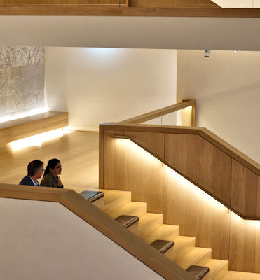
CURRENT MILA DEVELOPMENTS
Stakeholder event in January 2025, bringing together partners and funders to identify collaborative projects.
With a new government in the UK, promoting MILA’s policy briefing aimed at politicians and policymakers.
Coordinating a joint response from relevant organisations to the review of the school curriculum in England.
Advocating for a holistic approach to MIL in the curriculum
Collaboration with ParentZone on project around YouTube’s Hit Pause resource.

Slide 12
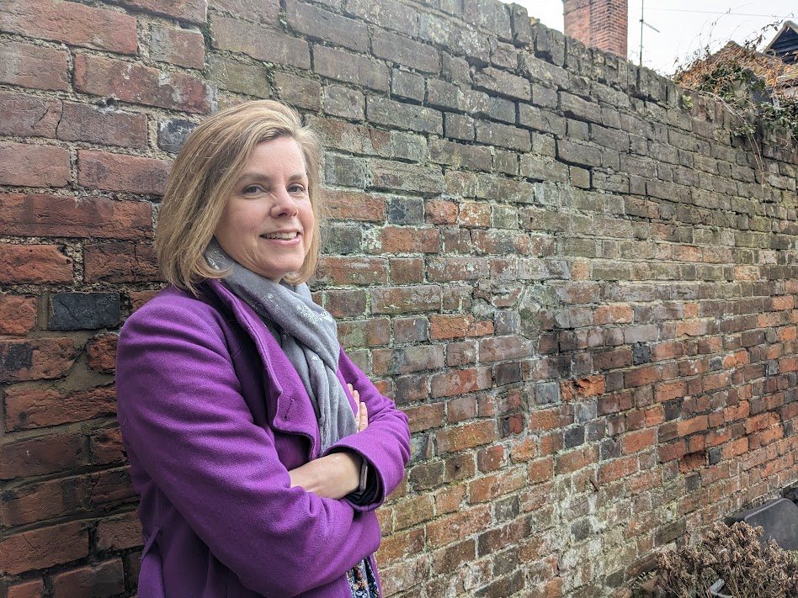
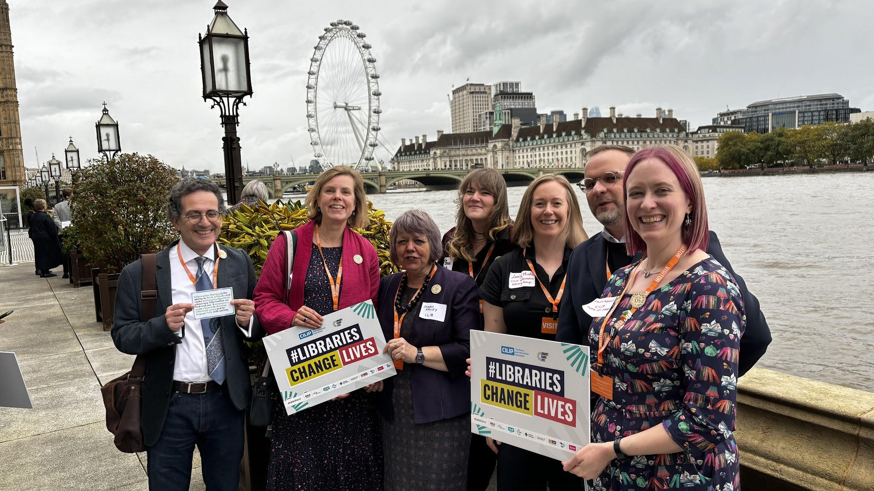
THE ROLE OF LIBRARIANS AND EDUCATORS
Expertise and practical experience teaching / supporting information literacy in a wide variety of contexts.
Research not digital, media and information literacy in a wide variety of contexts.
Transferable skills developed in schools, colleges and higher education.
Vital role in healthcare – for patients and clinicians.
The strength of the public library network – although not without limitations.
Network and collaboration skills and willingness to partner with others.

Slide 13

Thank you for your INTEREST!
www.mila.org.uk

